Slide 1

GUI application to detect Slow Wave activities in smart closed loop multi-channel recording and stimulation system for the development of healthy and diseased stomach
EENG 890,891 : Master’s Thesis
2017-2018
by
Pratik Sheth
Master of Science in Electrical and Computer Engineering
Under the guidance of
Dr Aydin Farajidavar
Assistant Professor, New York Institute of Technology, Old Westbury

Slide 2
Pathway
1
Introduction
2
Problem
3
Solution
4
5
Experimental Results
Conclusion
6
Future Scope

Slide 3
True Story

Slide 4
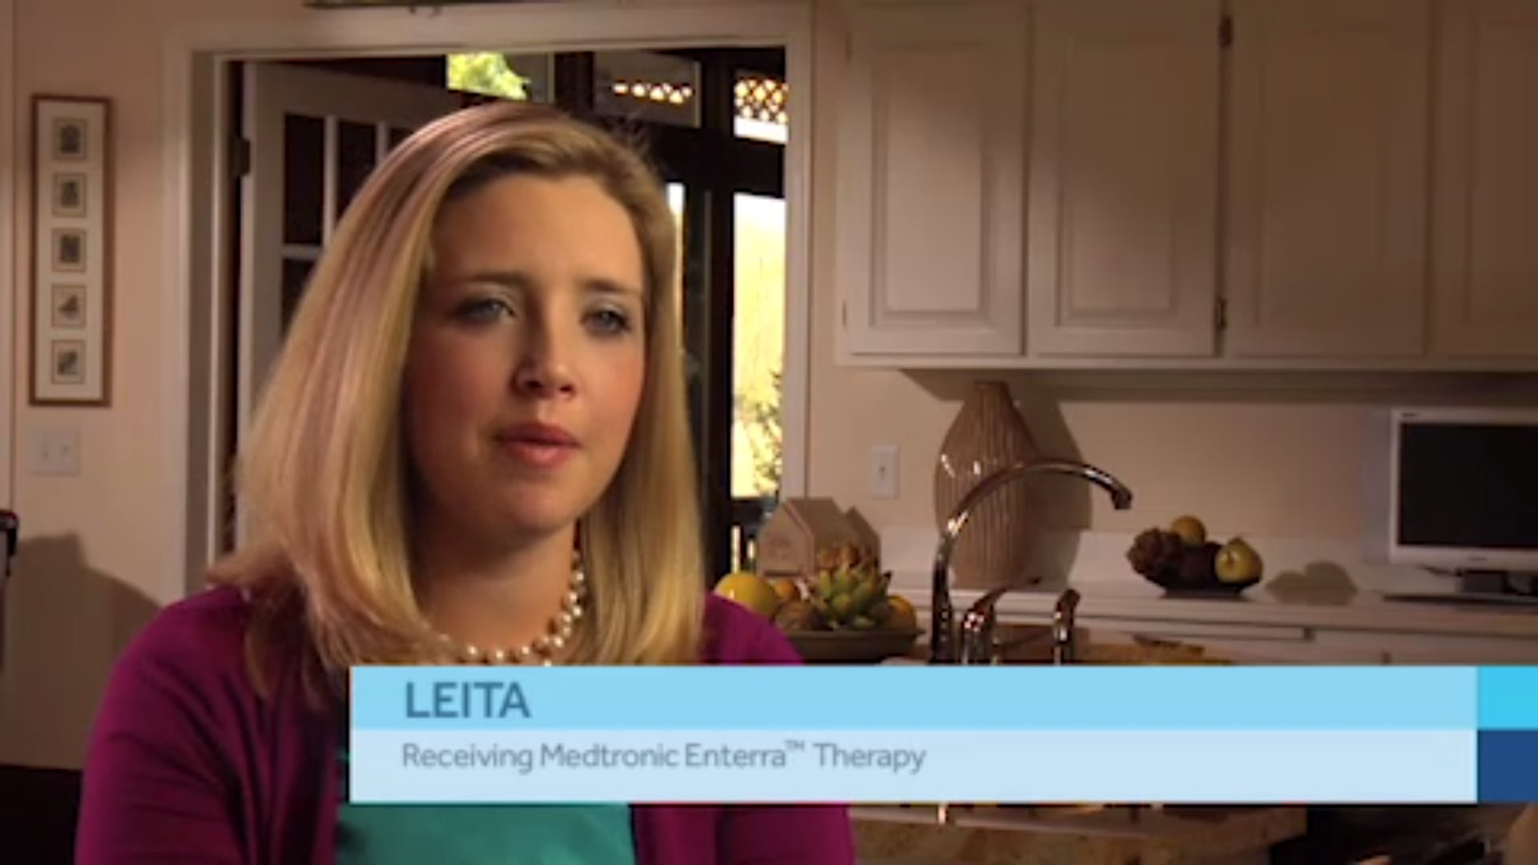
Leita Story
A student studying for her PhD in cellular and molecular biology.
She woke up one day with earache and nausea.
She started her busy day working at the lab, but soon her symptoms worsened to include an increased heart rate, shaking in her arms and sensitivity to light.
Within 3 days she experienced vertigo and nausea and couldn’t keep down food or drink.
Doctors explained that bulimia, an ear infection or meningitis might be causes thought none seemed to fit.
A series of tests eventually revealed that Leita had gastroparesis.

Slide 5
Introduction

Slide 6
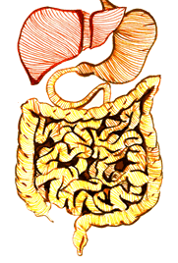
Gastrointestinal Tract
GI is an organ system within humans and animals which takes food, digest it to extract and absorb energy and nutrients.
Mouth, stomach, intestines and anus are part of human GI system.
Stomach plays an important role in the digestive system.
The main function of stomach includes secretion, digestion, mixing and emptying. It secretes acids and enzymes that digest food.

Slide 7
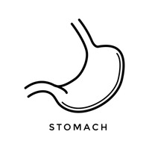
Anatomy of Stomach
Stomach is characterised into three sections namely fundus, corpus and antrum.
Fundus is the uppermost portion of the stomach which connects oesophagus to the stomach.
Below fundus is the corpus, the main part of the stomach located between the upper and lower parts.
Antrum is lower portion near the intestine, where the food mixes with gastric juices.

Slide 8
Gastric Motility
Contraction and relaxation of stomach is a physical or mechanical event.
During this process, electrical changes are taking place.
Electrical events occurs in the muscle during resting and active condition.
Electrical potential difference across the cell membrane of the muscle during resting condition is called resting membrane potential.
Action potential is defined as a series of electrical changes that occur in the membrane potential when the muscle is stimulated.

Slide 9
Bioelectrical Activities
Interstitial Cells of Cajal (ICC) are found in the gastrointestinal tract.
ICC acts as a pacemaker which creates bioelectrical slow wave potential which leads to contractions that mix and propel digestive contents.
Bioelectrical activities are mainly characterized into two major pattern namely a rhythmic electrical signals called as slow waves and smooth muscle action potential called as spike activity.
Bioelectrical activities coordinate gastric motility and slow wave activity is thought to contribute to motility disorders.

Slide 10
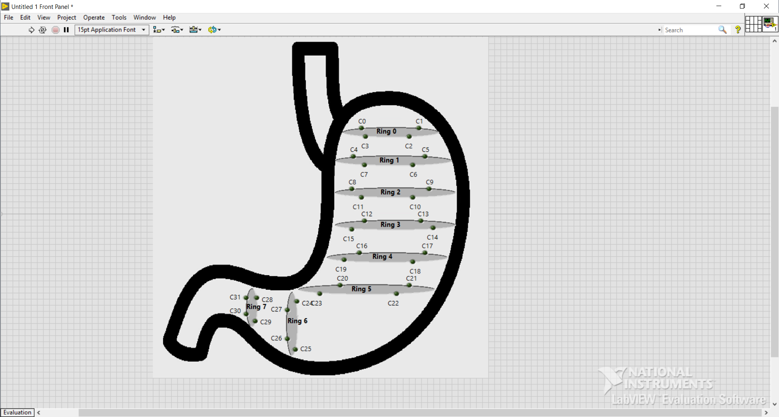
Pattern of Slow wave propagation
The slow wave is originates in upper corpus of the stomach and migrating along the circumference of the stomach towards the antrum at increasing velocity.
The slow wave can propagate antegrade as well as retrograde.

Slide 11
Problem

Slide 12
The physiology of normal gastric myoelectrical activity is 3 cycles per minute.
The concept of gastric dysrhythmias in the stomach.
Gastric dysrhythmias are correlated with increase or decrease magnitude of stimuli.
If physiology of gastric myoelectrical activity is less than 3 cycles per minute than it is termed as bradygastria.
If physiology of gastric myoelectrical activity is more than 3 cycles per minute than it is termed as tachygastria

Slide 13
Solution

Slide 14
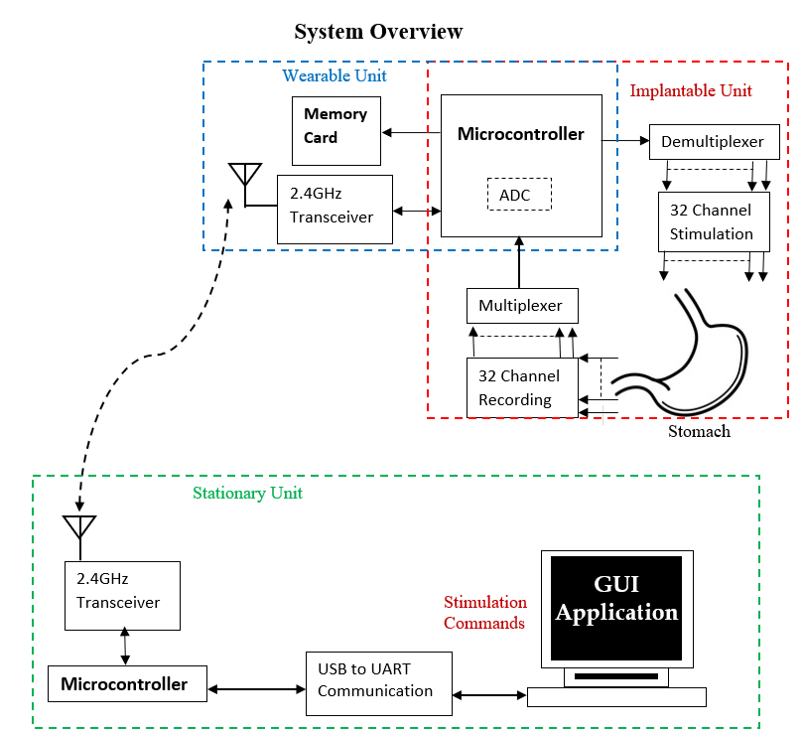
GUI application is designed to detect slow wave activities and characterised the physiology of gastric myoelectrical activity.
Electrical stimulation of specific pulse parameter are applied to the position of electrodes. Thus, patients with gastroparesis have been treated

Slide 15
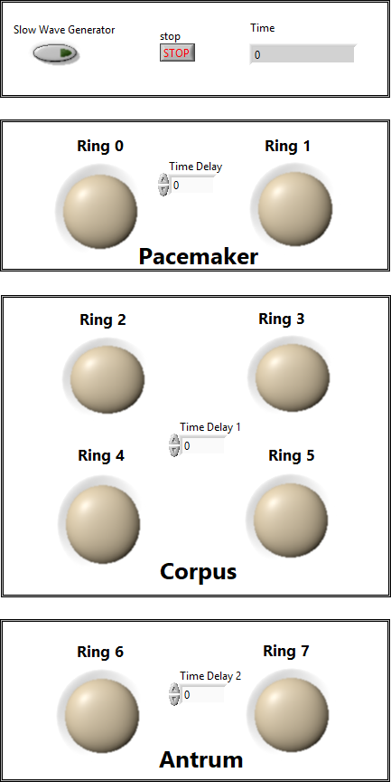
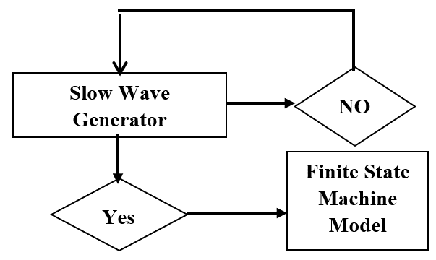
Virtual Stomach Model
(A)
(B)

Slide 16
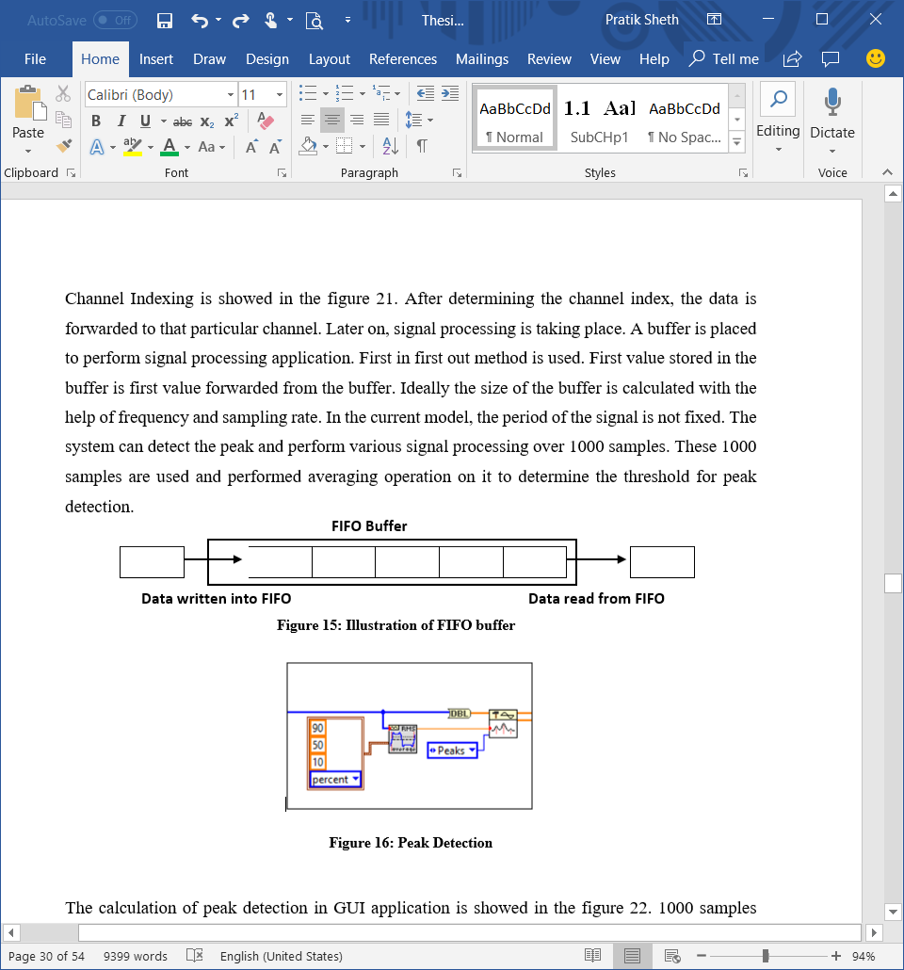
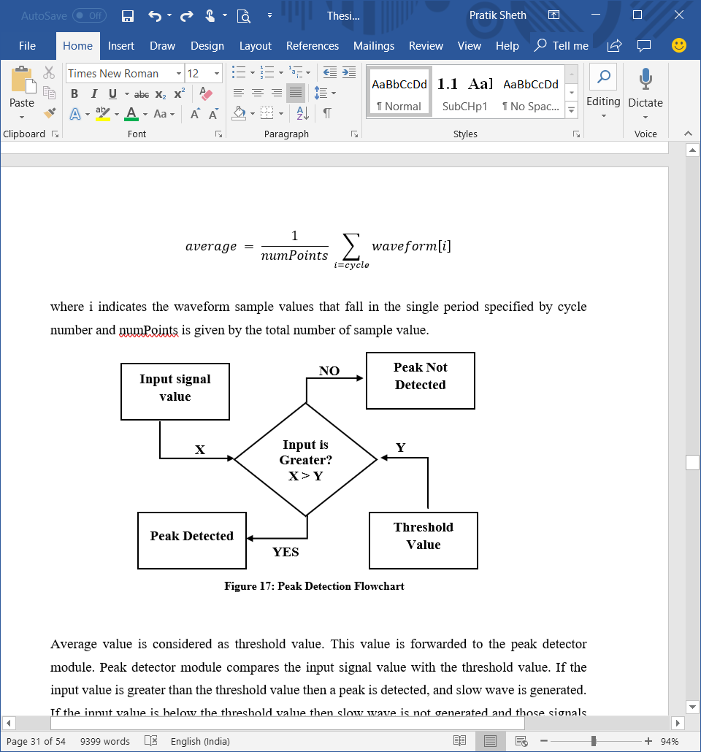
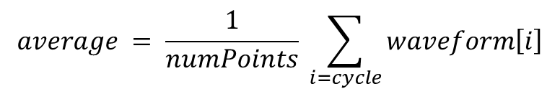
Peak Detection
$$average = \frac{1}{numPoints} \sum_{i=cycle}{waveform\left[i\right]}$$
where i indicates the waveform sample values that fall in the single period specified by cycle number and numPoints is given by the total number of sample value.

Slide 17
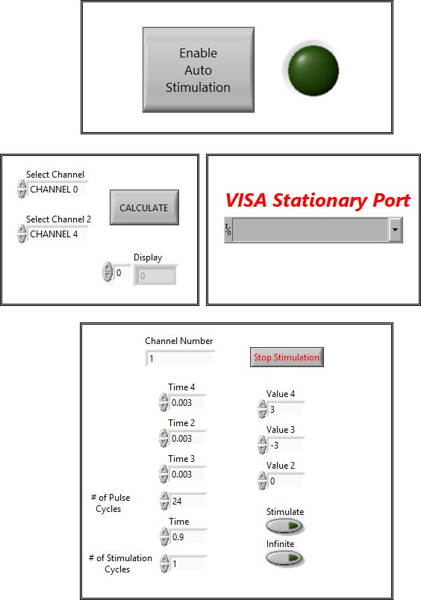
Calculation of Time
(B)
Channel 0
Channel 31
Peak Detected
Peak Detected
Channel 1 - 30
(A)
Time Stamp
Time Stamp
Subtractor

Slide 18
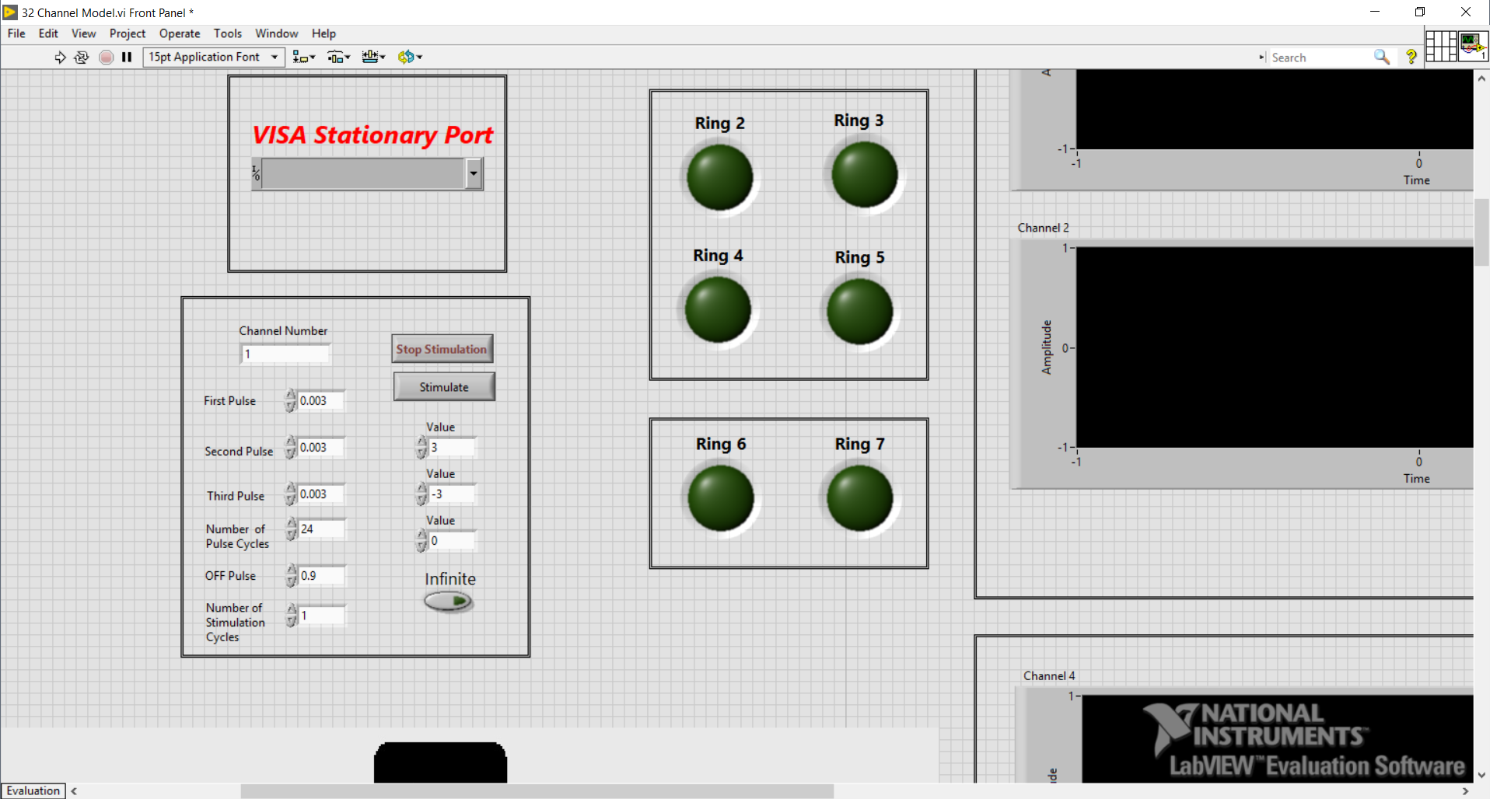
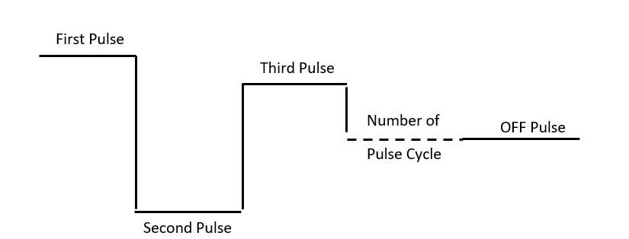
Stimulation
Stimulation is the process for raising levels of nervous activity in the stomach.
The user can apply stimulation pulses in two different modes namely finite and infinite.

Slide 19
Experimental Results

Slide 20
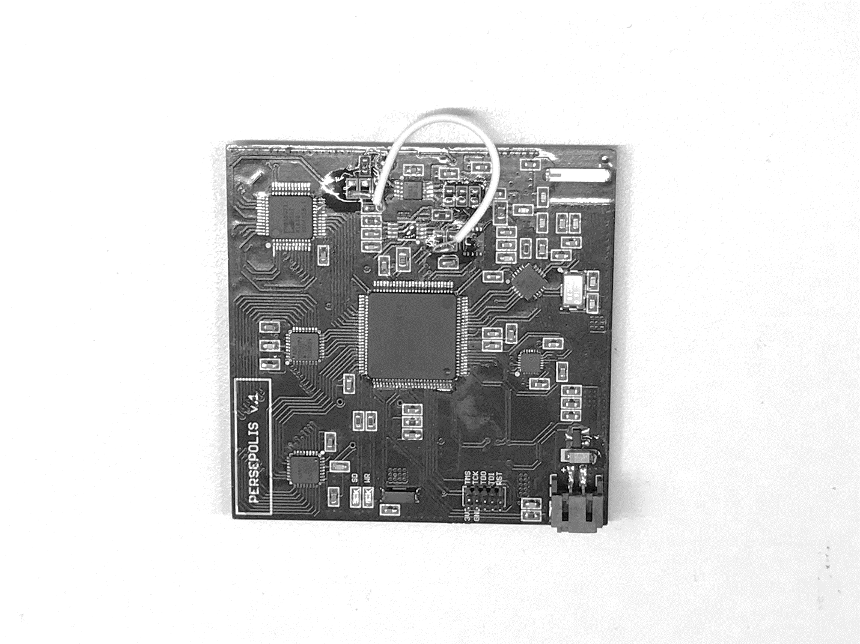
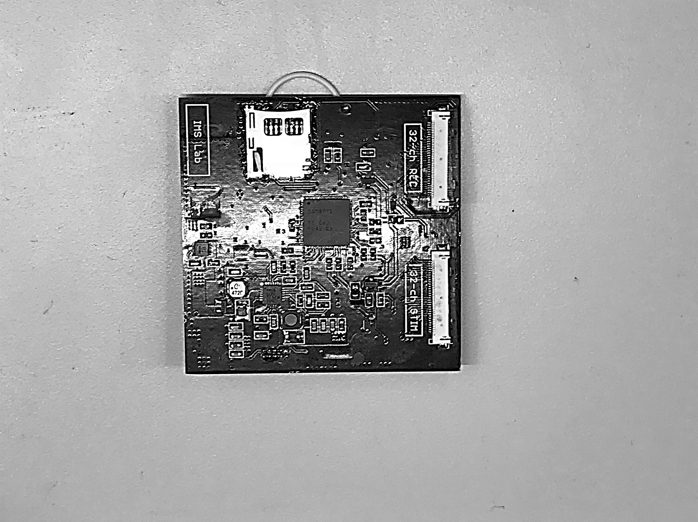
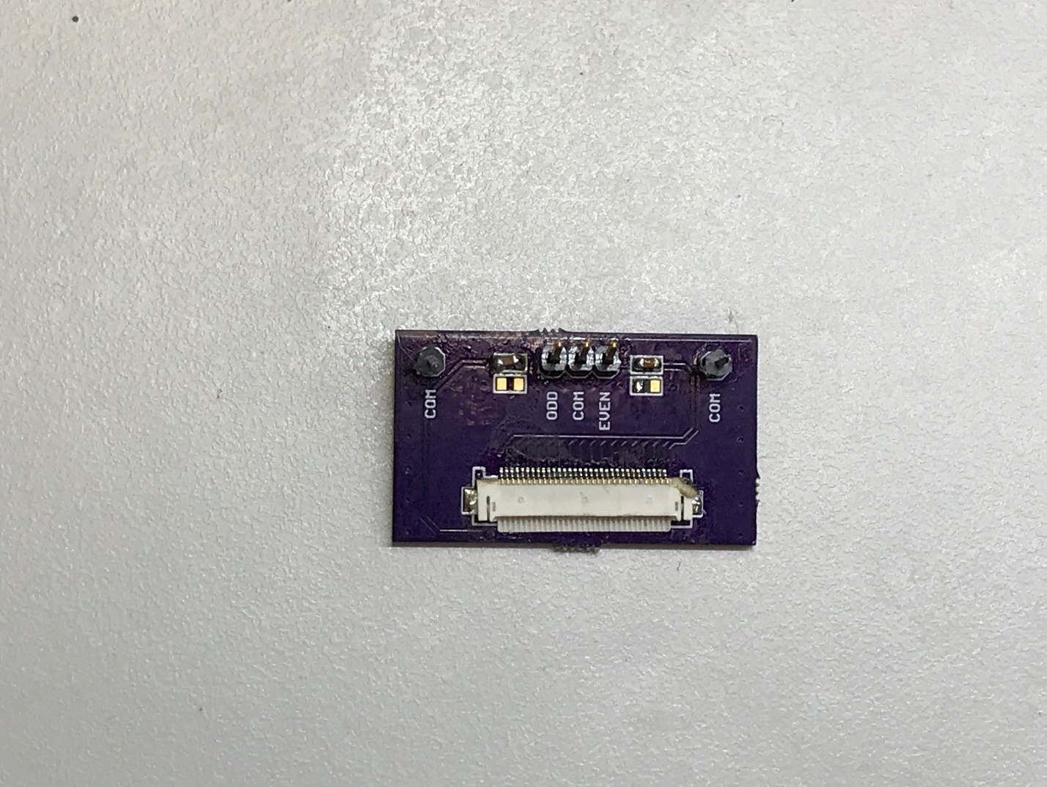
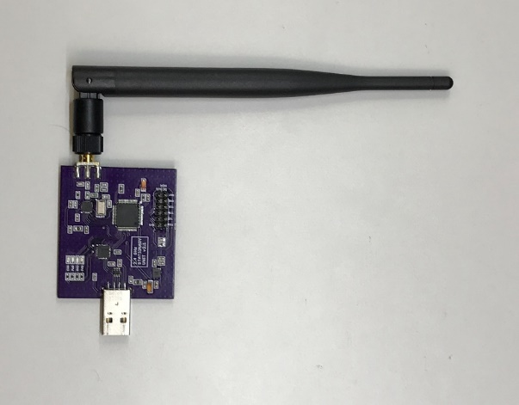
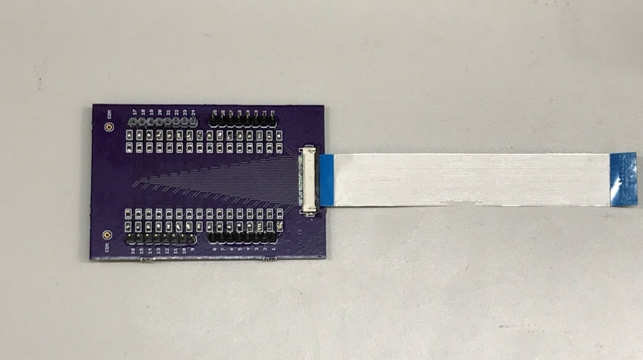
Experimental Procedure
(D)
(B)
(C)
(A)
(E)
PIG’s Dataset
EVEN and ODD channel test
Saline Test
Stimulation Test

Slide 21
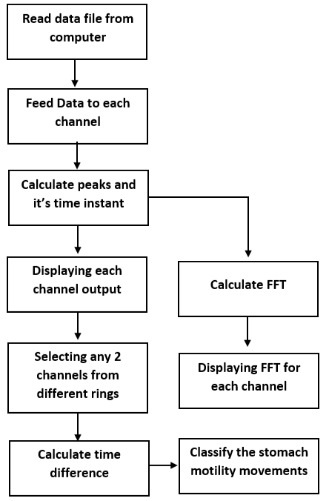
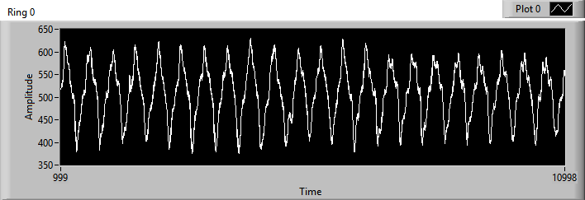
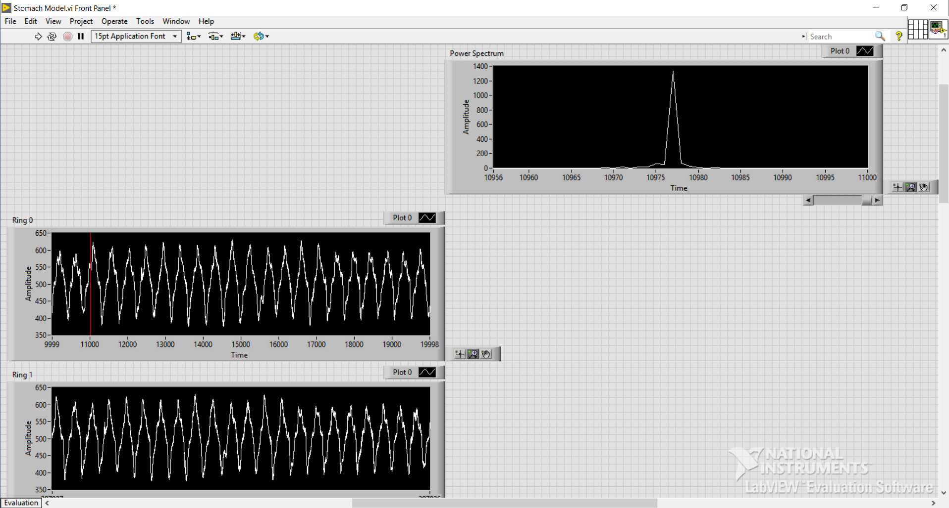
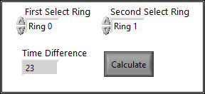
PIG’s Dataset
PIG’s Dataset
(A)
(B)
(C)
(D)

Slide 22
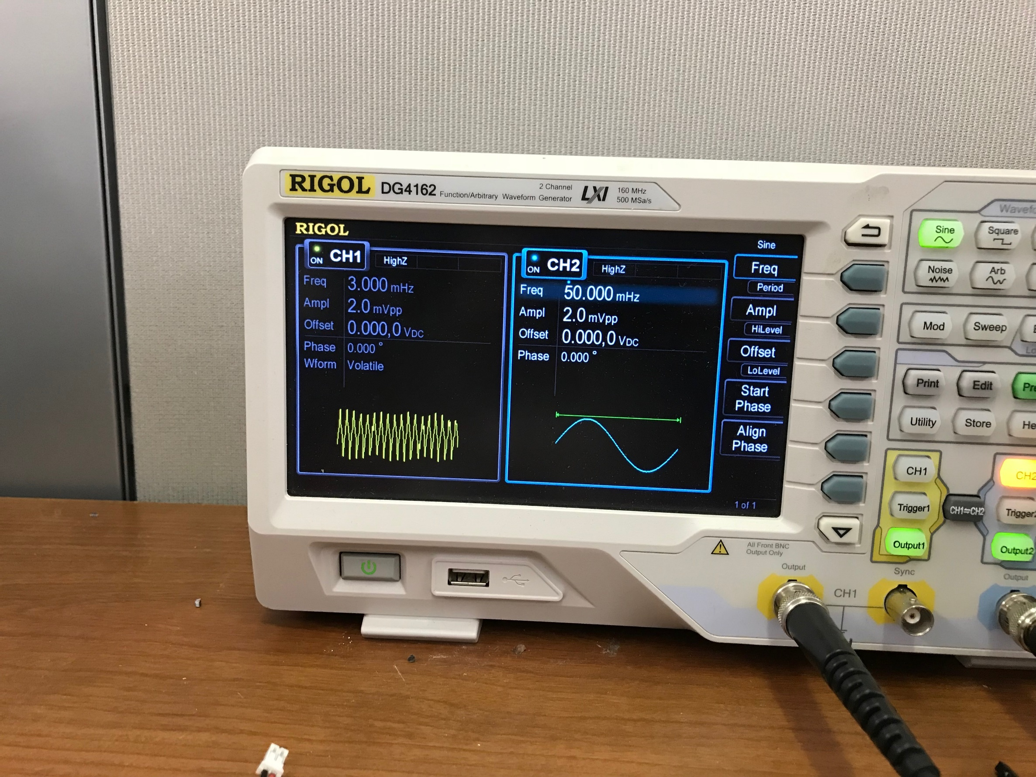
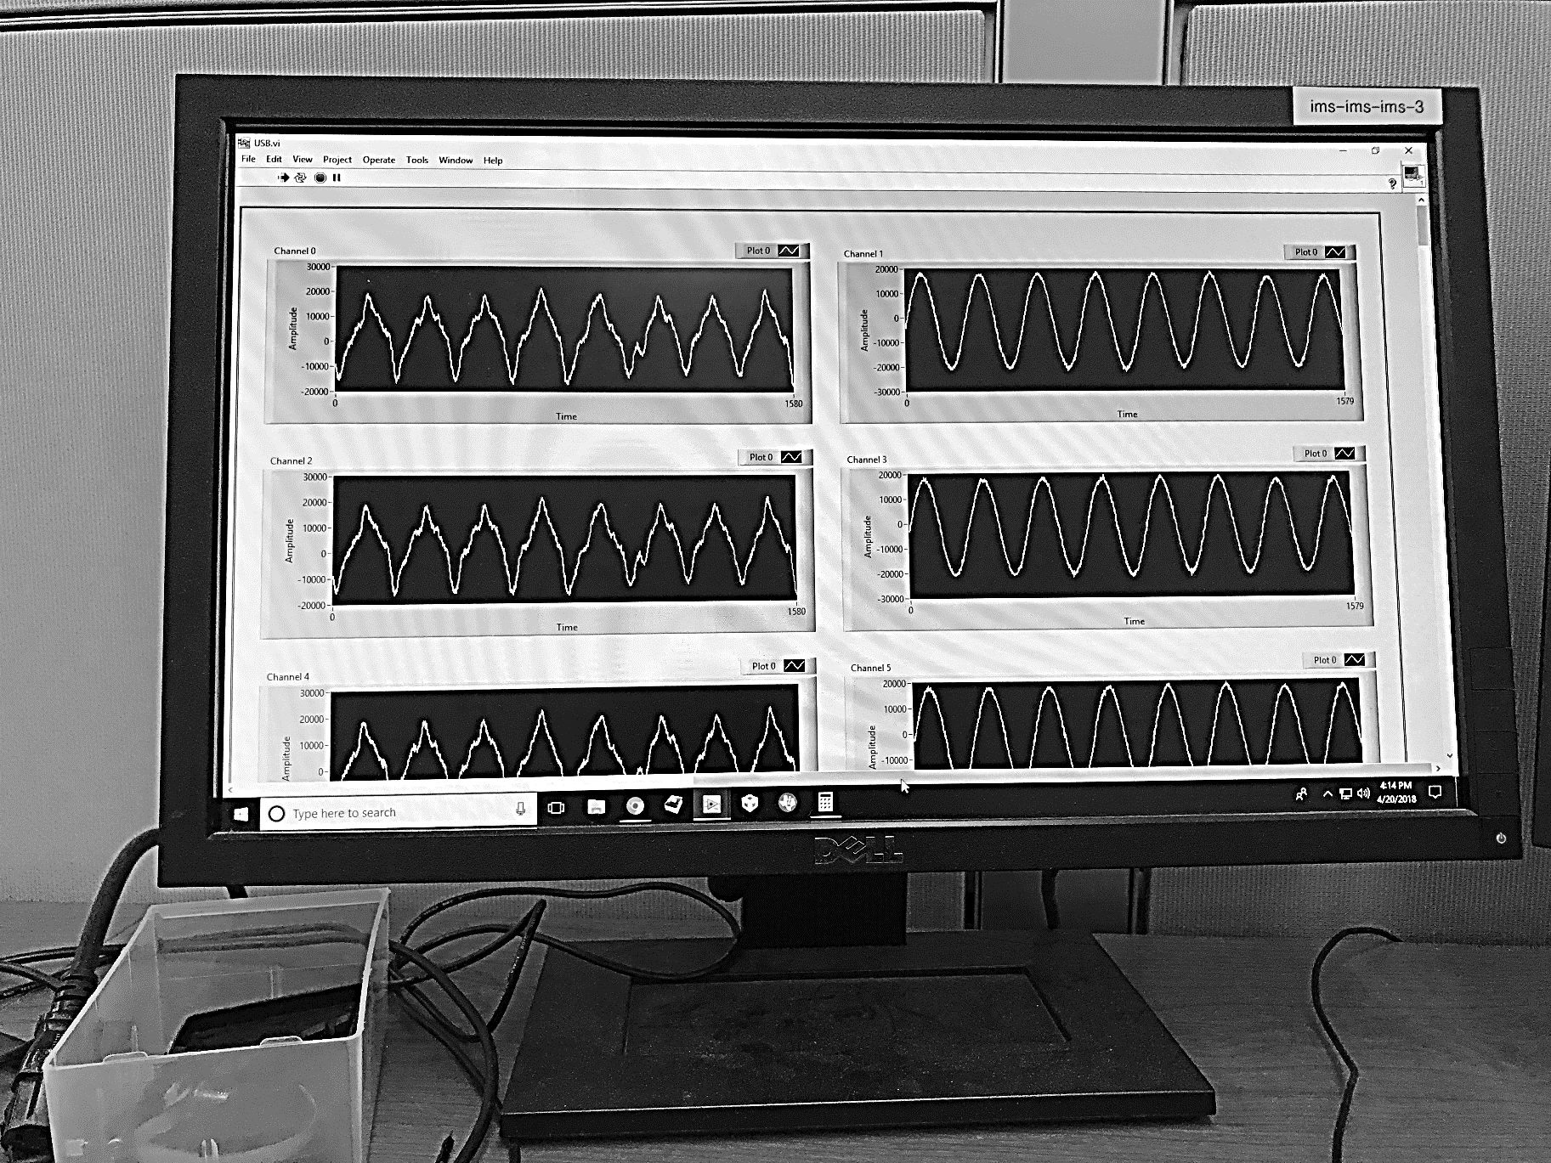
Even and Odd channel test
(A)
(B)

Slide 23
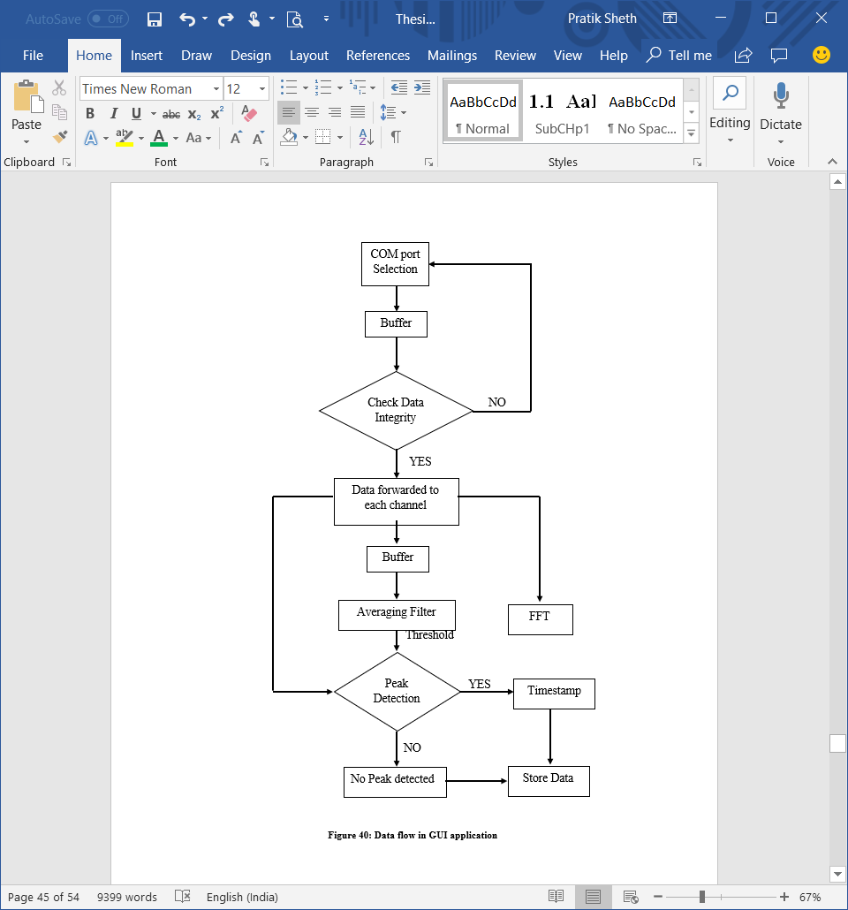
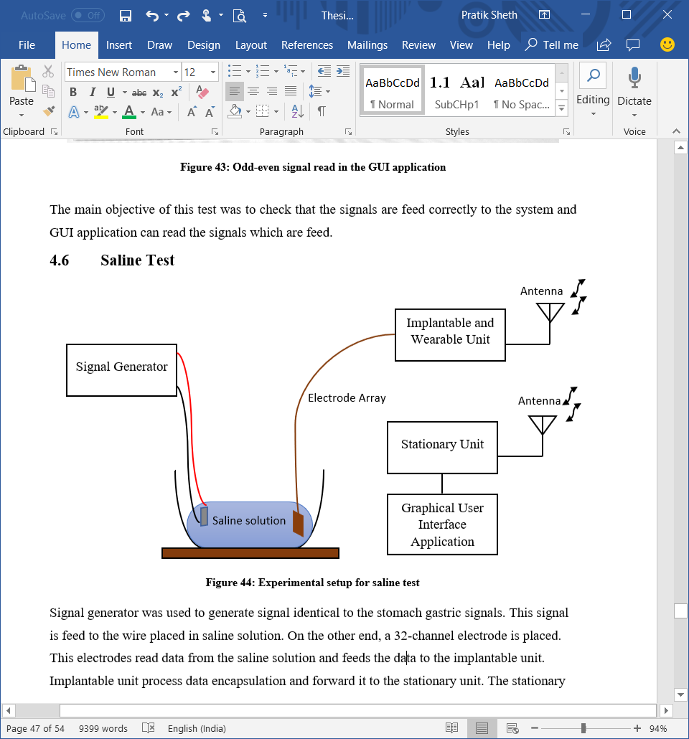
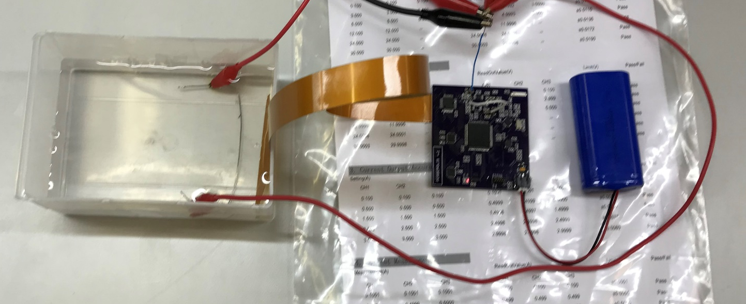
Saline Test
(B)
(C)
(A)

Slide 24
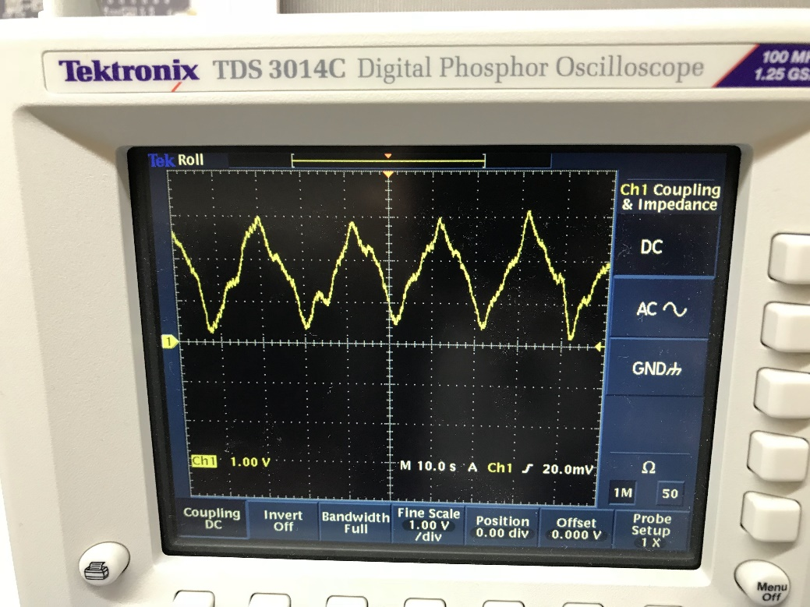
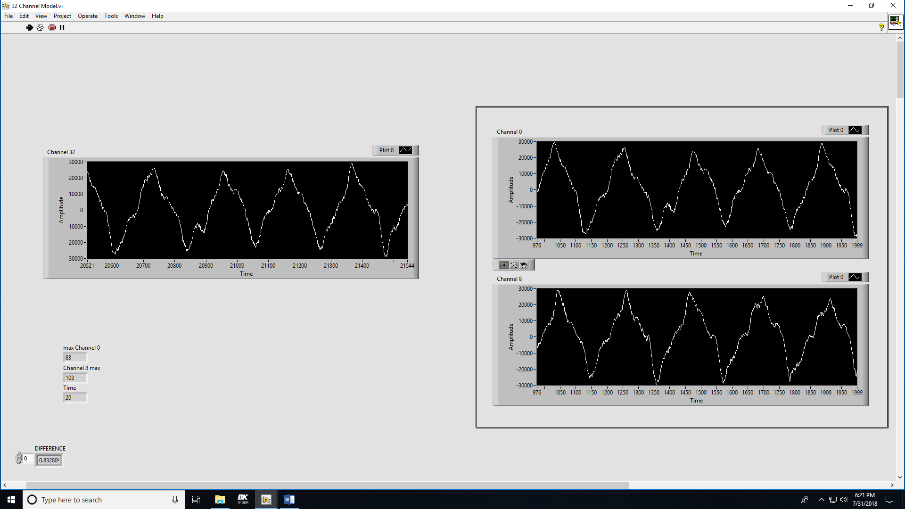
(A)
(B)
(C)

Slide 25
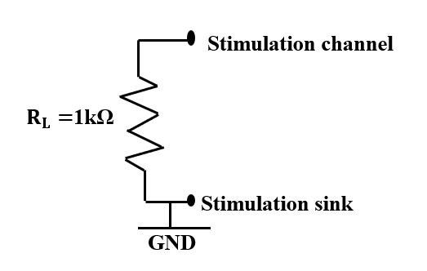
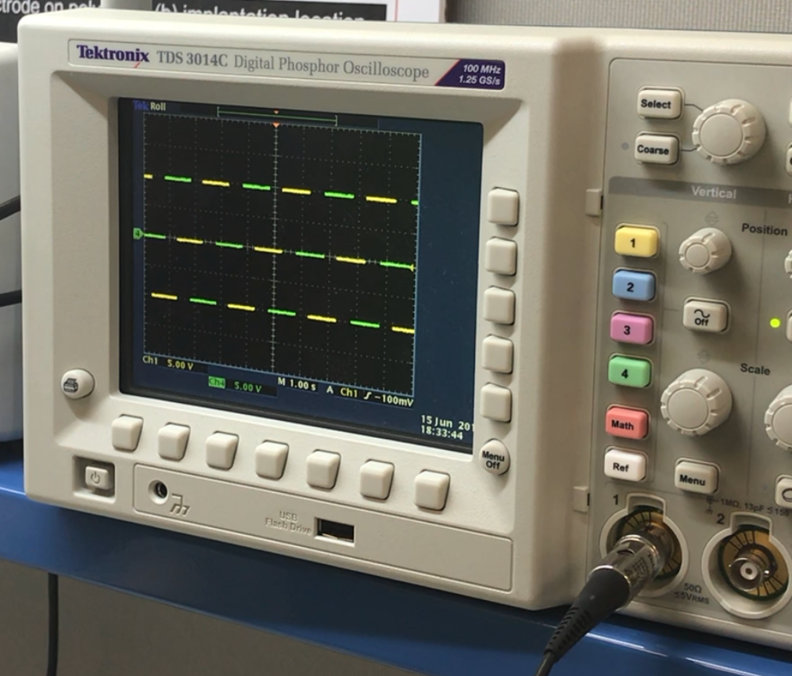
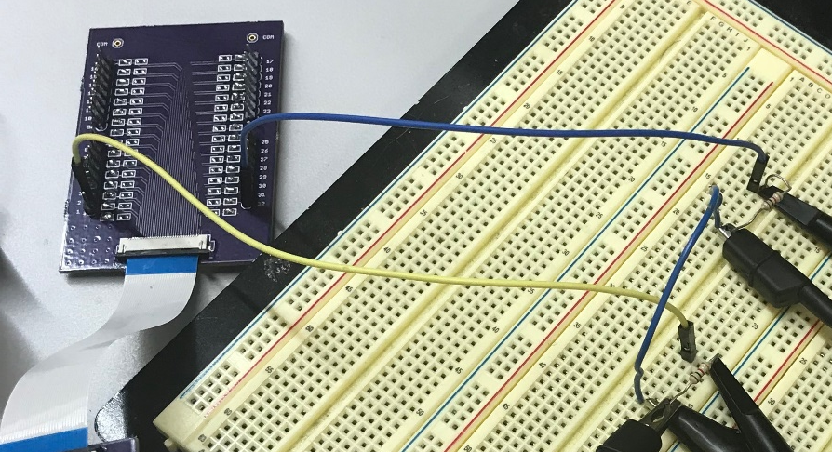
Stimulation
(A)
(D)
(B)
(C)

Slide 26
Conclusion

Slide 27
Conclusion
This study has employed a new generation of mapping techniques to provide the origin and propagation of human gastric slow wave activity.
The mapping and mathematical model evaluates circumferential gastric slow wave conduction.
The GUI application model is capable of the recording real-time data from 32-channels and applying stimulation pulses to each 32-channels.
The system can detect slow wave with different frequency and amplitude.
Ideally, three cycles per minute a slow wave is detected for healthy stomach models ie the stomach detects peak every 20 seconds.
An experiment also demonstrated the capability to apply short pulse stimulation, long pulse stimulation and a train of pulse stimulation.

Slide 28
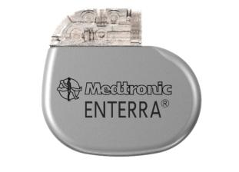

Medtronic Enterra
In the fall of 1999, the FDA designated the gastric electrical stimulation Enterra™ Therapy system as a Humanitarian Use Device.
The Enterra™ model 3116 gastric neurotransmitter is a programmable, implantable device that generates mild electrical pluses to treat chronic, intractable nausea and vomiting from gastroparesis caused by diabetes.
Enterra® II model is more compactible than Enterra model with electromagnetic interference.

Slide 29
Future Scope

Slide 30
Future Scope
The major drawback of the system is that recording, and stimulation cannot be performed simultaneously. Any one of the process can be processed at a time instant. Future models should record and stimulate simultaneously.
The system is successfully tested in laboratory. The technique and findings can be applied for in-vivo experiments to offer new opportunities to understand the nature of human gastric dysrhythmias.
Dysrhythmia in gastroparesis may include depletion of ICC. The structure of ICC network changes. This increases the variations in gastric slow wave conductivity. Future models should include these parameters in order to develop insights into gastric dysrhythmias.

Slide 31

Questions?

Slide 32

Thank You!!!

